Slide 1



AngularJS 1 Form Validation
Mark J. Buckler
OCPJP,CIWJS

Slide 2

Credits
Some of the contents of this slide presentation have been referenced and reproduced, from Learning AngularJS 1, by Ray Villalobos, ©2018 LinkedIn Corporation.

Slide 3
LEARNING OBJECTIVES
AngularJS Review
How AngularJS Validation Works
Using Validation Rules
AngularJS and Dynamic Styling
AngularJS and Form Submissions

Slide 4
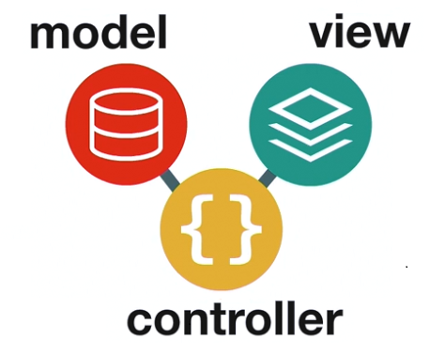
AngularJS Review
Model View Controller Architecture - MVC

Slide 5
AngularJS Review
Implementing AngularJS in the HTML
Add the required AngularJS libraries with <script> elements to the HTML, or View, file
AngularJS scripts should always be placed at the top of the file, in the <head> element
Denote the area of the HTML file to be managed by AngularJS by using an ng-app directive
Test the Model with two way data binding
Employ an ng-model directive on an <input> field with a named value
Test the binding with an AngularJS expression

Slide 6

AngularJS Review
Programming Exercise05_01_01 – Step 1
Setting Up the Project
Adding AngularJS to the Form

Slide 7
How AngularJS Validation Works
Traditional HTML Validation
Accomplished with standard HTML attributes required maxlength=”20”
AngularJS uses directives to accomplish validation ng-required ng-minlength ng-pattern
HTML validation should be turned off before using AngularJS validation
Can be done with an HTML novalidation attribute placed on the <form> element

Slide 8
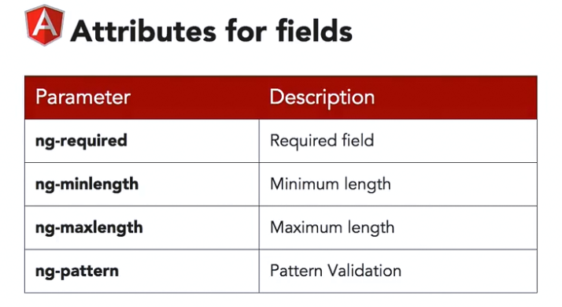
How AngularJS Validation Works
AngularJS Validation Directives

Slide 9
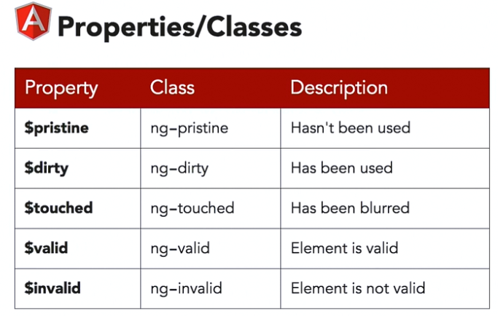
How AngularJS Validation Works
AngularJS Validation Properties & Classes
When the validation directives are used, two things are generated for each model
Properties – added and which may be checked for validity
Classes – injected and which may be used for styling

Slide 10
How AngularJS Validation Works
Programming Exercise05_01_01 – Step 2
Using AngularJS Validation Properties
Examining AngularJS Validation Class Behavior

Slide 11
How AngularJS Validation Works
AngularJS Validation Properties & Classes
When the validation directives are used, two things are generated for each model
Properties – added and which may be checked for validity
Classes – injected and which may be used for styling

Slide 12
Using Validation Rules
Programming Exercise05_01_01 – Step 3
Using AngularJS Validation Properties

Slide 13
AngularJS and Dynamic Styling
Programming Exercise05_01_01 – Step 4
Using AngularJS to Add Dynamic Styling

Slide 14
AngularJS and Form Submissions
Programming Exercise05_01_01 – Step 5
Implementing and AngularJS Form Submission

